Slide 1


Social Buzz’s content Categories Analysis

Slide 2


Today's agenda
Project recap
Problem
The Analytics team
Process
Insights
Summary

Slide 3

Social Buzz, a rapidly growing tech unicorn, must quickly adapt to its global expansion. Accenture has launched a 3-month proof of concept (POC) with the following focus areas:
Conducting an audit of Social Buzz's big data practices
Providing recommendations for a successful IPO
Analyzing to identify Social Buzz's top 5 most popular content categories
Project Recap

Slide 4

Problem
Social Buzz faces;
Rapid growth as they get 100, 000 pieces of content daily
Strained resources with lack of experience in dealing with huge data
To be able to capitalize on this huge data
They need ;
An analysis to find Social Buzz's top 5 most popular categories of content

Slide 5



ANDREW FLEMING
Chief Technology Architect
The Analytics team
MARCUS ROMPTON
Senior Principal
LESSMOURN NDLOVU
Data Analyst

Slide 6
Process
1
Data Understanding
2
Data Cleaning
3
Data Modelling
4
Data Analysis
5
Uncover Insights

Slide 7






Insights
Animals has the highest popularity with 1897 reactions
Photo has the highest count of 6589 for Content Type
There are 16 unique categories
Has the highest number of posts, 2138 posts

Slide 8
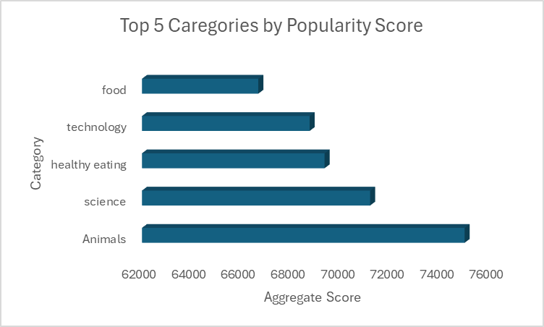

Slide 9
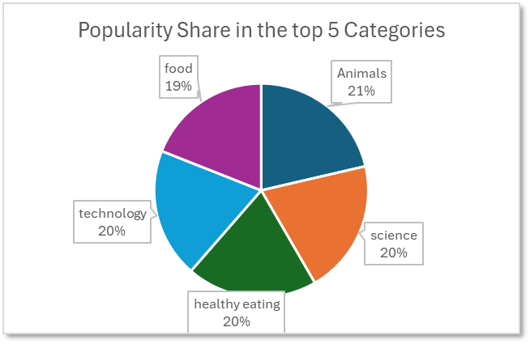

Slide 10

There are 4 types of content out of which users prefer photos the most
Out of the 16 different content categories, Animals is the most popular one.
56% of the content in the Animals category comprises of only photos and videos
May has the highest number of posts followed by January.
To drive growth and engagement, Social Buzz should prioritize its top five content categories—animals, technology, science, healthy eating, and food. By tailoring campaigns to specifically target audiences interested in these areas. Additionally, Social Buzz should focus its strategic efforts on maximizing engagement in May and January, as these months historically show the highest volume of posts. This could include launching special promotions, seasonal content, or interactive campaigns to leverage peak activity periods.
Summary

Slide 11

Thank you!
ANY QUESTIONS?

